Slide 1
Hotel Database
Abdul Wasay 1812254

Slide 2
Project Description
The hotel has many types of rooms (standard, deluxe, executive). Each room can have one or more occupancy type (single, twin, double) and a maximum capacity.
Each occupancy type has a minimum and maximum number of guests.
Each room can have one or more additional attributes (including road facing, wheel chair accessible, smoking/non-smoking, pool side, etc).
The hotel can have various rate types. For each rate type, there can be many rates for different types of rooms at different dates.

Slide 3
Project Description
The hotel also provides number of other facilities like rate of breakfasts and etc.
The hotel has room service and other services such as hair salon, car hire, laundary and etc with rates for each of them.
Customers can book one or more room for a future date or be a walk in customer.
Database keeps track of customer record to report on repeat customers

Slide 4
Data Details
50 rooms * 20 Days of usage per year (occupancy of about 60%) * 5 items consumed per day * 2 years= 10,000 rows.
4 different room types * avg 2 different occupancy types * 5 different rate types * avg 6 seasons per year* 3 years = 720 records.

Slide 5
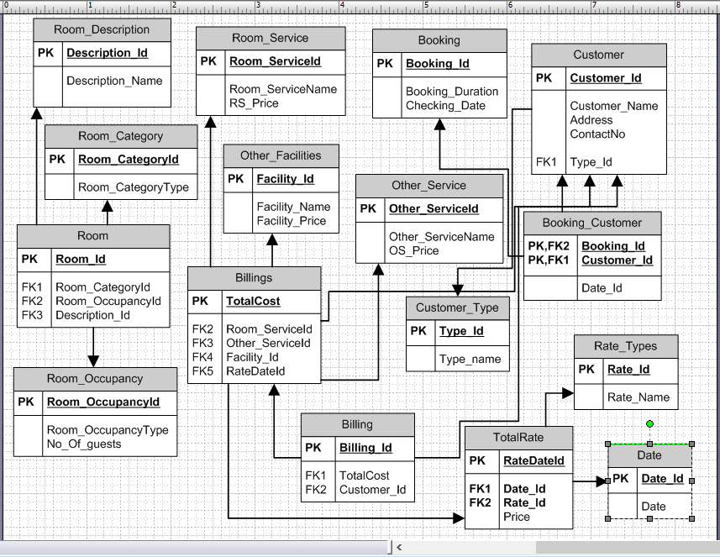
ERD – Entity relationship diagram

Slide 6
Objectives
Occupancy rate for different months/weeks/days.
Actual revenue from room rent vs potential revenue for a date range.
Bill of a customer for the whole stay (could have more than one rooms).
Percentage of repeat business coming in month by month.
List of room types and their rates available based on date range and additional attributes.

